Slide 1

Introduction to
Social Network
Analysis!
Kelsey Campbell
Data Scientist
@campkels

Slide 2

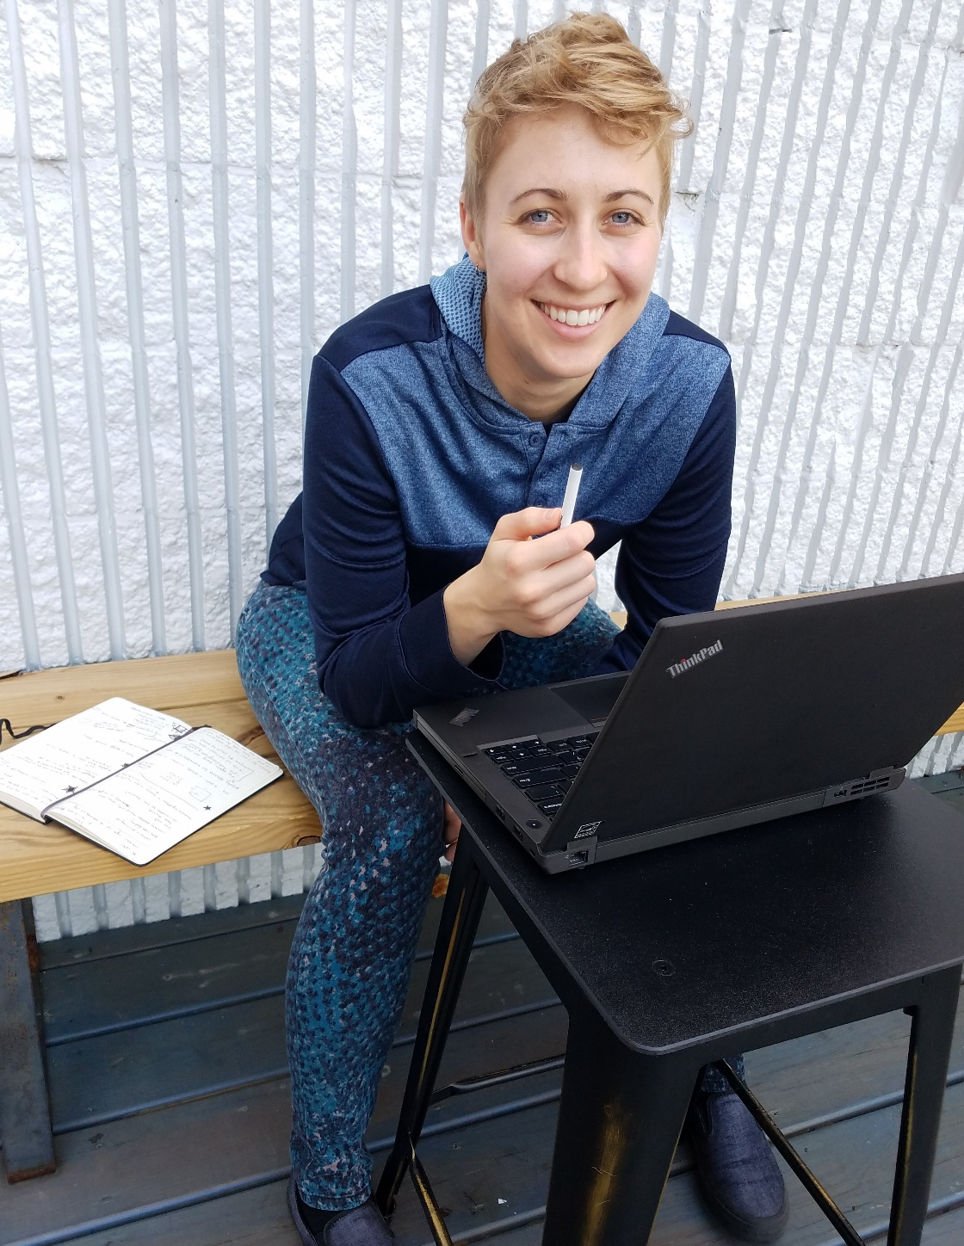

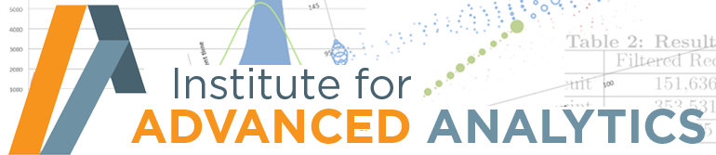


Hi!
Economics - 2011
Public Health Research
MSA - 2016
Kelsey (they/she)
Notes:
Brief intro of my background

Slide 3
Social Network Analysis (SNA)
Powerful & versatile methods to gain insight into complicated social connection patterns
Applications across industry and academia – SO MANY OPTIONS!
Network Analysis 101
Notes:
Goals of the session
Agenda:
1. Network Analysis 101
2. Real life SNA applications
3. Demo
4. Queer Health Hackathon Submission

Slide 4
Social Network Analysis (SNA)
Powerful & versatile methods to gain insight into complicated social connection patterns
Applications across industry and academia – SO MANY OPTIONS!
SNA IRL
Network Analysis 101
Notes:
Goals of the session
Agenda:
1. Network Analysis 101
2. Real life SNA applications
3. Demo
4. Queer Health Hackathon Submission

Slide 5


Social Network Analysis (SNA)
Powerful & versatile methods to gain insight into complicated social connection patterns
Applications across industry and academia – SO MANY OPTIONS!
DEMO!
Network Analysis 101
SNA IRL
Notes:
Goals of the session
Agenda:
1. Network Analysis 101
2. Real life SNA applications
3. Demo
4. Queer Health Hackathon Submission

Slide 6
Social Network Analysis (SNA)
Powerful & versatile methods to gain insight into complicated social connection patterns
Applications across industry and academia – SO MANY OPTIONS!
Queer Health Hackathon
Network Analysis 101
SNA IRL
DEMO
Notes:
Goals of the session
Agenda:
1. Network Analysis 101
2. Real life SNA applications
3. Demo
4. Queer Health Hackathon Submission

Slide 7

Social Network Analysis (SNA)
Powerful & versatile methods to gain insight into complicated social connection patterns
Applications across industry and academia – SO MANY OPTIONS!
Network Analysis 101
SNA IRL
DEMO
Queer Health Hackathon
Notes:
Goals of the session
Agenda:
1. Network Analysis 101
2. Real life SNA applications
3. Demo
4. Queer Health Hackathon Submission

Slide 8
Social Network Analysis (SNA)
Investigating social structures through networks/graphs
Nodes (circles) –
people, actors, things, concepts, etc
Edges (lines) –
connection between 2 nodes (relationship, interaction, etc)
Network Analysis 101
SNA IRL
DEMO
Queer Health Hackathon
Notes:
SNA is using networks/graphs to recognize complicated patterns and dynamics in social relationship data.
Explain structure of a graph (nodes/edges)

Slide 9
Building a Social Network
Ginny
Harry
Student | House
Harry | Gryffindor
Ginny | Gryffindor
Dean | Gryffindor
Ron | Gryffindor
Hermione | Gryffindor
Cedric | Hufflepuff
Hannah | Hufflepuff
Penny | Hufflepuff
Helga | Hufflepuff
Dean
Cedric
Hermione
Ron
Hannah
Penny
Helga
Network Analysis 101
SNA IRL
DEMO
Queer Health Hackathon
Notes:
Walkthrough a simple example of how you would build a social network.

Slide 10
Building a Social Network
Node Table
Ginny
Harry
Student | House
Harry | Gryffindor
Ginny | Gryffindor
Dean | Gryffindor
Ron | Gryffindor
Hermione | Gryffindor
Cedric | Hufflepuff
Hannah | Hufflepuff
Penny | Hufflepuff
Helga | Hufflepuff
Dean
Cedric
Hermione
Ron
Hannah
Penny
Helga
Network Analysis 101
SNA IRL
DEMO
Queer Health Hackathon
Notes:
Walkthrough a simple example of how you would build a social network.

Slide 11
Building a Social Network
Edge Table
Node1 | Node2 | Weight
Harry | Ginny | 5
Harry | Ron | 1
Harry | Cedric | 2
Harry | Hermione | 3
Ginny | Dean | 1
Ginny | Hermione | 3
Ginny | Ron | 4
Hermione | Ron | 1
Ron | Cedric | 5
Cedric | Hannah | 3
Hannah | Helga | 1
Hannah | Penny | 4
Helga | Penny | 5
Node Table
Ginny
Harry
Student | House
Harry | Gryffindor
Ginny | Gryffindor
Dean | Gryffindor
Ron | Gryffindor
Hermione | Gryffindor
Cedric | Hufflepuff
Hannah | Hufflepuff
Penny | Hufflepuff
Helga | Hufflepuff
Dean
Cedric
Hermione
Ron
Hannah
Penny
Helga
Network Analysis 101
SNA IRL
DEMO
Queer Health Hackathon
Notes:
Walkthrough a simple example of how you would build a social network.

Slide 12
Building a Social Network
Edge Table
Node1 | Node2 | Weight
Harry | Ginny | 5
Harry | Ron | 1
Harry | Cedric | 2
Harry | Hermione | 3
Ginny | Dean | 1
Ginny | Hermione | 3
Ginny | Ron | 4
Hermione | Ron | 1
Ron | Cedric | 5
Cedric | Hannah | 3
Hannah | Helga | 1
Hannah | Penny | 4
Helga | Penny | 5
Node Table
Ginny
Harry
Student | House
Harry | Gryffindor
Ginny | Gryffindor
Dean | Gryffindor
Ron | Gryffindor
Hermione | Gryffindor
Cedric | Hufflepuff
Hannah | Hufflepuff
Penny | Hufflepuff
Helga | Hufflepuff
Dean
Cedric
Hermione
Ron
Hannah
Penny
Helga
Network Analysis 101
SNA IRL
DEMO
Queer Health Hackathon
Notes:
Walkthrough a simple example of how you would build a social network.

Slide 13
Building a Social Network
Edge Table
Node1 | Node2 | Weight
Harry | Ginny | 5
Harry | Ron | 1
Harry | Cedric | 2
Harry | Hermione | 3
Ginny | Dean | 1
Ginny | Hermione | 3
Ginny | Ron | 4
Hermione | Ron | 1
Ron | Cedric | 5
Cedric | Hannah | 3
Hannah | Helga | 1
Hannah | Penny | 4
Helga | Penny | 5
Node Table
Ginny
Harry
Student | House
Harry | Gryffindor
Ginny | Gryffindor
Dean | Gryffindor
Ron | Gryffindor
Hermione | Gryffindor
Cedric | Hufflepuff
Hannah | Hufflepuff
Penny | Hufflepuff
Helga | Hufflepuff
Dean
Cedric
Hermione
Ron
Hannah
Penny
Helga
Network Analysis 101
SNA IRL
DEMO
Queer Health Hackathon
Notes:
Walkthrough a simple example of how you would build a social network.

Slide 14
Building a Social Network
Edge Table
Node1 | Node2 | Weight
Harry | Ginny | 5
Harry | Ron | 1
Harry | Cedric | 2
Harry | Hermione | 3
Ginny | Dean | 1
Ginny | Hermione | 3
Ginny | Ron | 4
Hermione | Ron | 1
Ron | Cedric | 5
Cedric | Hannah | 3
Hannah | Helga | 1
Hannah | Penny | 4
Helga | Penny | 5
Node Table
Ginny
Harry
Student | House
Harry | Gryffindor
Ginny | Gryffindor
Dean | Gryffindor
Ron | Gryffindor
Hermione | Gryffindor
Cedric | Hufflepuff
Hannah | Hufflepuff
Penny | Hufflepuff
Helga | Hufflepuff
Dean
Cedric
Hermione
Ron
Hannah
Penny
Helga
Network Analysis 101
SNA IRL
DEMO
Queer Health Hackathon
Notes:
Walkthrough a simple example of how you would build a social network.

Slide 15
Building a Social Network
Edge Table
Node1 | Node2 | Weight
Harry | Ginny | 5
Harry | Ron | 1
Harry | Cedric | 2
Harry | Hermione | 3
Ginny | Dean | 1
Ginny | Hermione | 3
Ginny | Ron | 4
Hermione | Ron | 1
Ron | Cedric | 5
Cedric | Hannah | 3
Hannah | Helga | 1
Hannah | Penny | 4
Helga | Penny | 2
Node Table
Ginny
Harry
Student | House
Harry | Gryffindor
Ginny | Gryffindor
Dean | Gryffindor
Ron | Gryffindor
Hermione | Gryffindor
Cedric | Hufflepuff
Hannah | Hufflepuff
Penny | Hufflepuff
Helga | Hufflepuff
Dean
Cedric
Hermione
Ron
Hannah
Penny
Helga
Network Analysis 101
SNA IRL
DEMO
Queer Health Hackathon
Notes:
Mention how edges can also have attributes – for example can weight by frequency.

Slide 16
Building a Social Network
Edge Table
Node1 | Node2 | Weight
Harry | Ginny | 5
Harry | Ron | 1
Harry | Cedric | 2
Harry | Hermione | 3
Ginny | Dean | 1
Ginny | Hermione | 3
Ginny | Ron | 4
Hermione | Ron | 1
Ron | Cedric | 5
Cedric | Hannah | 3
Hannah | Helga | 1
Hannah | Penny | 4
Helga | Penny | 2
Node Table
Ginny
Harry
Student | House
Harry | Gryffindor
Ginny | Gryffindor
Dean | Gryffindor
Ron | Gryffindor
Hermione | Gryffindor
Cedric | Hufflepuff
Hannah | Hufflepuff
Penny | Hufflepuff
Helga | Hufflepuff
Dean
Cedric
Hermione
Ron
Hannah
Penny
Helga
Network Analysis 101
SNA IRL
DEMO
Queer Health Hackathon
Notes:
Explain the difference between directed and undirected graphs.

Slide 17
Building a Social Network
Edge Table
Node1 | Node2 | Weight
Harry | Ginny | 5
Harry | Ron | 1
Harry | Cedric | 2
Harry | Hermione | 3
Ginny | Dean | 1
Ginny | Hermione | 3
Ginny | Ron | 4
Hermione | Ron | 1
Ron | Cedric | 5
Cedric | Hannah | 3
Hannah | Helga | 1
Hannah | Penny | 4
Helga | Penny | 2
Penny | Helga | 2
Node Table
Ginny
Harry
Student | House
Harry | Gryffindor
Ginny | Gryffindor
Dean | Gryffindor
Ron | Gryffindor
Hermione | Gryffindor
Cedric | Hufflepuff
Hannah | Hufflepuff
Penny | Hufflepuff
Helga | Hufflepuff
Dean
Cedric
Hermione
Ron
Hannah
Penny
Helga
Queer Health Hackathon
Network Analysis 101
SNA IRL
DEMO
Recap & Wrap Up
Queer Health Hackathon
Notes:
Illustrate how you will need extra edge rows if a directed relationship is reciprocated.

Slide 18
Building a Social Network
Edge Table
Node1 | Node2 | Weight
Harry | Ginny | 5
Harry | Ron | 1
Harry | Cedric | 2
Harry | Hermione | 3
Ginny | Dean | 1
Ginny | Hermione | 3
Ginny | Ron | 4
Hermione | Ron | 1
Ron | Cedric | 5
Cedric | Hannah | 3
Hannah | Helga | 1
Hannah | Penny | 4
Helga | Penny | 5
Node Table
Ginny
Harry
Student | House
Harry | Gryffindor
Ginny | Gryffindor
Dean | Gryffindor
Ron | Gryffindor
Hermione | Gryffindor
Cedric | Hufflepuff
Hannah | Hufflepuff
Penny | Hufflepuff
Helga | Hufflepuff
Dean
Cedric
Hermione
Ron
Hannah
Penny
Helga
Network Analysis 101
SNA IRL
DEMO
Queer Health Hackathon
Notes:
For simplicity, we will just consider the unweighted, undirected graph.

Slide 19
Building a Social Network
Ginny
Harry
Dean
Cedric
Hermione
Ron
Hannah
Penny
Helga
Network Analysis 101
SNA IRL
DEMO
Queer Health Hackathon
Notes:
Can already see some interesting patterns from the visualization
Houses are pretty clustered into distinct groups, without a lot of mingling
Cedric seems to be a bridge between clusters, having friends with people in both houses
Some people are more connected than others, ex Harry compared to Dean

Slide 20
Building a Social Network
Ginny
Harry
Dean
Cedric
Hermione
Ron
Hannah
Penny
Helga
Network Analysis 101
SNA IRL
DEMO
Queer Health Hackathon
Notes:
Can already see some interesting patterns from the visualization
Houses are pretty clustered into distinct groups, without a lot of mingling
Cedric seems to be a bridge between clusters, having friends with people in both houses
Some people are more connected than others, ex Harry compared to Dean

Slide 21
Building a Social Network
Ginny
Harry
Dean
Cedric
Hermione
Ron
Hannah
Penny
Helga
Network Analysis 101
SNA IRL
DEMO
Queer Health Hackathon
Notes:
Can already see some interesting patterns from the visualization
Houses are pretty clustered into distinct groups, without a lot of mingling
Cedric seems to be a bridge between clusters, having friends with people in both houses
Some people are more connected than others, ex Harry compared to Dean

Slide 22
Building a Social Network
Ginny
Harry
Dean
Cedric
Hermione
Ron
Hannah
Penny
Helga
Network Analysis 101
SNA IRL
DEMO
Queer Health Hackathon
Notes:
Can already see some interesting patterns from the visualization
Houses are pretty clustered into distinct groups, without a lot of mingling
Cedric seems to be a bridge between clusters, having friends with people in both houses
Some people are more connected than others, ex Harry compared to Dean

Slide 23
Building a Social Network
Who is the most important or powerful person?
Who is the most influential?
Who are the critical links?
How easily can a node make connections?
What communities are present?
Ginny
Harry
Dean
Cedric
Hermione
Ron
Hannah
Penny
Helga
Network Analysis 101
SNA IRL
DEMO
Queer Health Hackathon
Notes:
SNA can help us answer some interesting questions about a network.

Slide 24
Network Statistics
Who is the most important or powerful person?
Who is the most influential?
Who are the critical links?
How easily can a node make connections?
What communities are present?
Centrality (Betweenness, Closeness, Eigenvector, In-degree, Out-degree…), Degree, Brokers/Bridges…
Connectivity, Distance, Closeness…
Closure, Homophily, Cliques…
Network Analysis 101
SNA IRL
DEMO
Queer Health Hackathon
Notes:
We answer these questions using a variety of network statistics. Brief explanation here, but I will go into depth with 3 common ones.

Slide 25
Network Statistics - Degree
Node-level statistic
= the number of connections each person has
Ginny
Harry
Dean
Cedric
Hermione
Ron
Hannah
Penny
Helga
Network Analysis 101
SNA IRL
DEMO
Queer Health Hackathon
Notes:
Overview of Degree, how to calculate, and interpretation.

Slide 26
Network Statistics - Degree
Node-level statistic
= the number of connections each person has
Ginny
Harry
4
4
Dean
1
3
4
Cedric
Hermione
Ron
3
3
Hannah
Penny
2
2
Helga
Network Analysis 101
SNA IRL
DEMO
Queer Health Hackathon
Notes:
Overview of Degree, how to calculate, and interpretation.

Slide 27
Network Statistics - Degree
Node-level statistic
= the number of connections each person has
Ginny
Harry
4
4
1
3
4
Cedric
Hermione
3
“Who is the most connected?”
Ron
3
Hannah
Penny
2
2
Helga
Network Analysis 101
SNA IRL
DEMO
Queer Health Hackathon
Notes:
Overview of Degree, how to calculate, and interpretation.

Slide 28
Network Statistics – Betweenness Centrality
Node-level statistic
Based on Shortest Paths
= sum of the proportion of all the shortest paths in the network that go through a node
Ginny
Harry
Dean
Cedric
Hermione
Ron
Hannah
Penny
Helga
Network Analysis 101
SNA IRL
DEMO
Queer Health Hackathon
Notes:
Overview of Betweenness Centrality, how to calculate(-ish), and interpretation.

Slide 29
Network Statistics – Betweenness Centrality
Node-level statistic
Based on Shortest Paths
= sum of the proportion of all the shortest paths in the network that go through a node
Ginny
Harry
Dean
7
6
0
0
6
Cedric
Hermione
Ron
15
12
Hannah
“Who has the most power?”
Penny
0
0
Helga
Network Analysis 101
SNA IRL
DEMO
Queer Health Hackathon
Notes:
Overview of Betweenness Centrality, how to calculate(-ish), and interpretation.

Slide 30
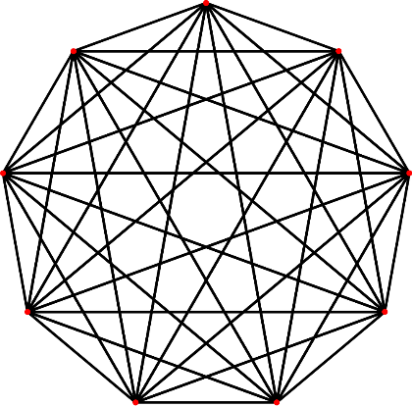
Network Statistics - Density
Network-level statistic
= the proportion of existing edges compared to the total possible
Ranges from 0 (graph without edges) to 1 (complete graph)
Ginny
Harry
Dean
Cedric
Hermione
Ron
Hannah
Penny
Helga
Network Analysis 101
SNA IRL
DEMO
Queer Health Hackathon
Notes:
Overview of Density, how to calculate, and interpretation.

Slide 31
Network Statistics - Density
Network-level statistic
= the proportion of existing edges compared to the total possible
Ranges from 0 (graph without edges) to 1 (complete graph)
Ginny
Harry
Dean
Cedric
Hermione
Ron
Hannah
Penny
“How condensed is the network?”
0.36
Helga
Network Analysis 101
SNA IRL
DEMO
Queer Health Hackathon
Notes:
Overview of Density, how to calculate, and interpretation.

Slide 32
Why SNA?
Instead of focusing on individuals in isolation,
SNA considers the importance of connections and relationships
= More Realistic Analyses?
Network Analysis 101
SNA IRL
DEMO
Queer Health Hackathon
Notes:
Why SNA is so powerful/why I like it.

Slide 33
Why SNA?
Organizational behavior (leadership, management)
Influencing groups (public health, propaganda, marketing)
Discovery opportunities (Math/Computer Science)
https://www.slideshare.net/DataWorksMD/social-network-analysis-workshop/
Network Analysis 101
SNA IRL
DEMO
Queer Health Hackathon
Notes:
Explain how SNA can be applied to a variety of disciplines, and how there is potential for new algorithmic and computing advancements.

Slide 34
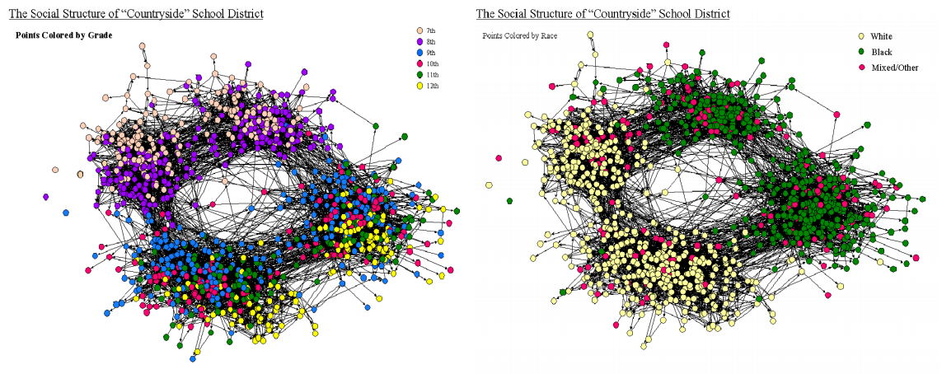
SNA Applications
James Moody (2001) “Race, School Integration, and Friendship in America”
Network Analysis 101
SNA IRL
DEMO
Queer Health Hackathon
Notes:
Famous sociology example that used SNA in a similar way to our simple example.
Study looked at friendships within a school, found there was both separation by grade level and race. Gets a bit into community detection features (which we didn’t go into) as this is an example of homophily.
Moody, James. “Race, School Integration, and Friendship Segregation in America.” American Journal of Sociology 107: 679-716.

Slide 35
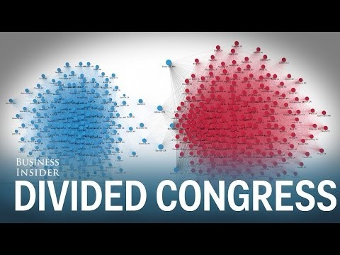
SNA Applications
Network Analysis 101
SNA IRL
DEMO
Queer Health Hackathon
Notes:
https://www.youtube.com/watch?v=tEczkhfLwqM
Short video showing the structure of U.S. Congress over time.

Slide 36
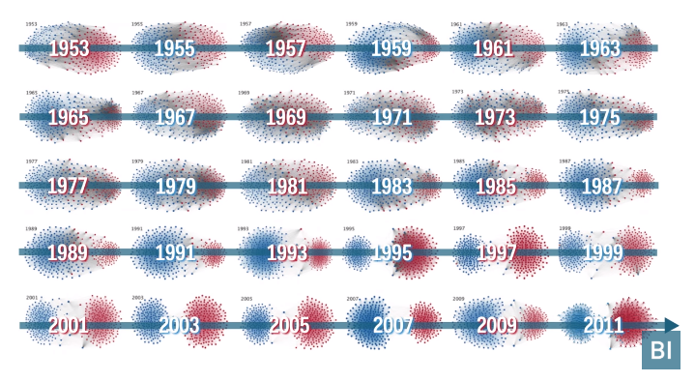
SNA Applications
Network Analysis 101
SNA IRL
DEMO
Queer Health Hackathon
Notes:
https://www.washingtonpost.com/news/wonk/wp/2015/04/23/a-stunning-visualization-of-our-divided-congress/
https://journals.plos.org/plosone/article?id=10.1371/journal.pone.0123507

Slide 37
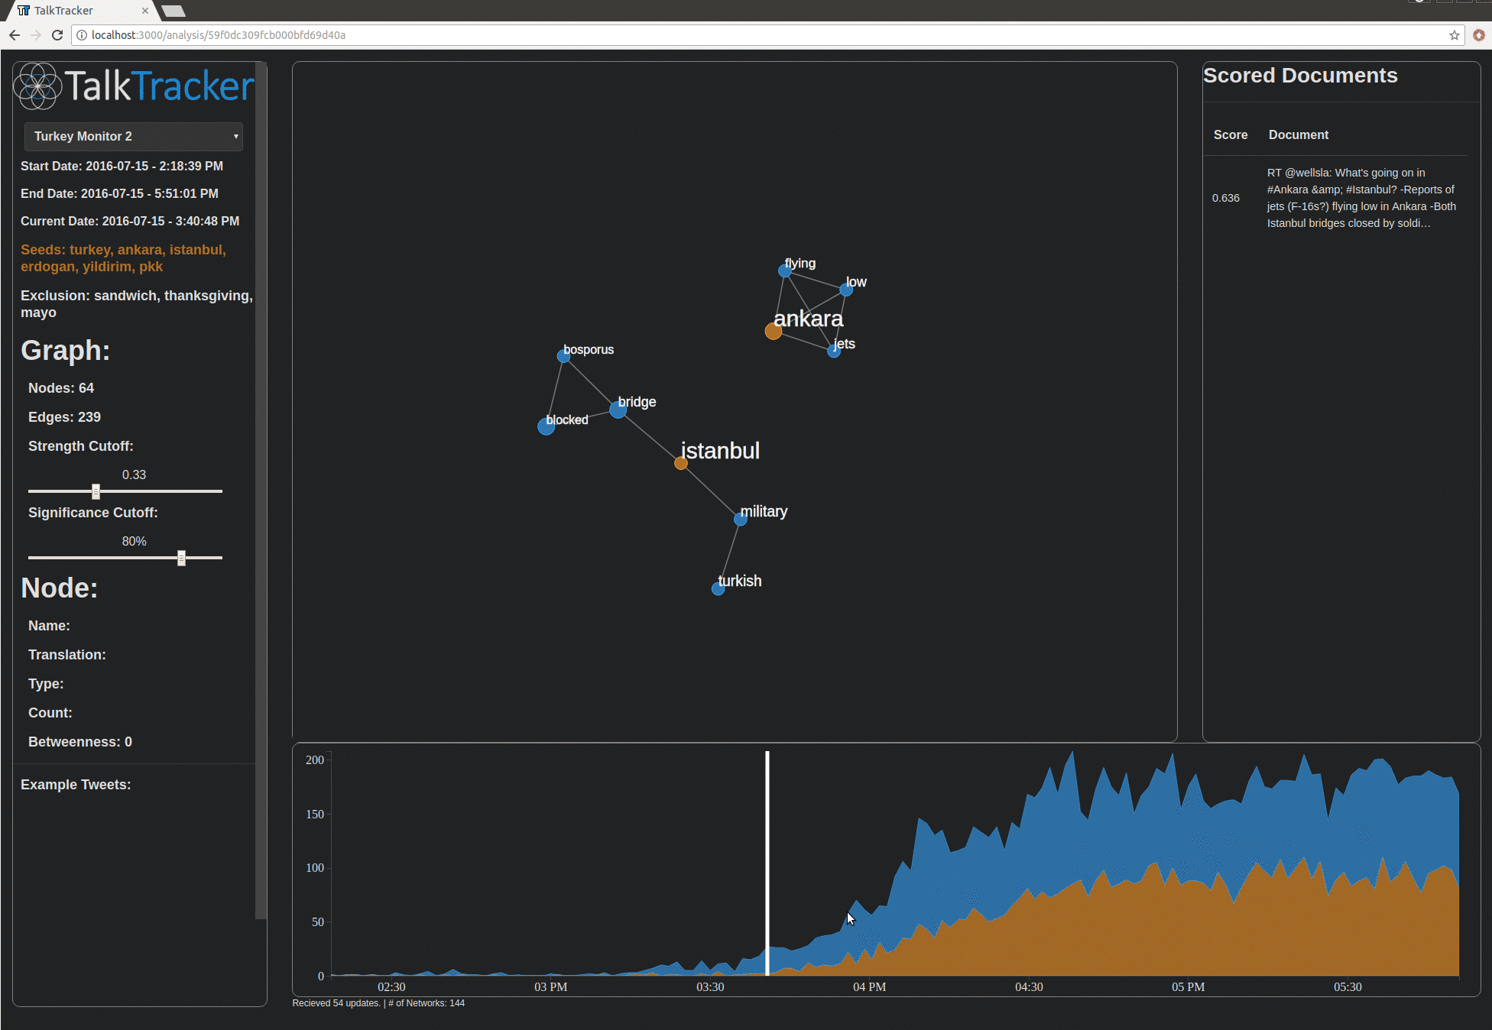

SNA Applications
Network Analysis 101
SNA IRL
DEMO
Queer Health Hackathon
Notes:
Mention a SNA prototype I was a part of creating at Visionist. Explain how this uses Twitter data, but not in the typical social network way (typically account focused) as we instead built word networks to track conversations over time.
The animated example looks at the conversation changing in response to the 2016 Turkish coup.

Slide 38

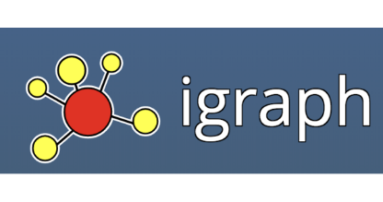

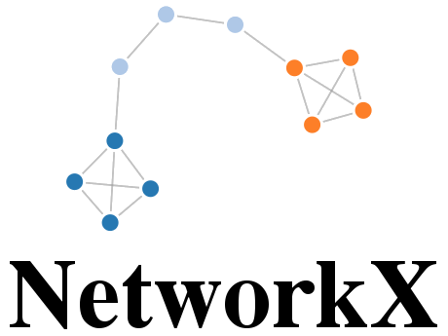










How to SNA
 | Analysis | Visualization
Other Open Source
Database, HPC
Network Analysis 101
SNA IRL
DEMO
Queer Health Hackathon
Notes:
Not a comprehensive list – just popular open-source platforms.
Analysis:
R – igraph
Python – Networkx, igraph wrapper (less support, but faster)
Visualization:
R – igraph
Python – matplotlib, plotly, bokeh
Open-Source Software – Gephi
Frontend – D3.js, vis.js, cytoscape.js
GraphDB: neo4j, graphdb
HPC: Spark GraphFrames (seems the most promising)

Slide 39
DEMO TIME!
https://github.com/campkels/Intro-SNA-Demo
Network Analysis 101
SNA IRL
DEMO
Queer Health Hackathon

Slide 40
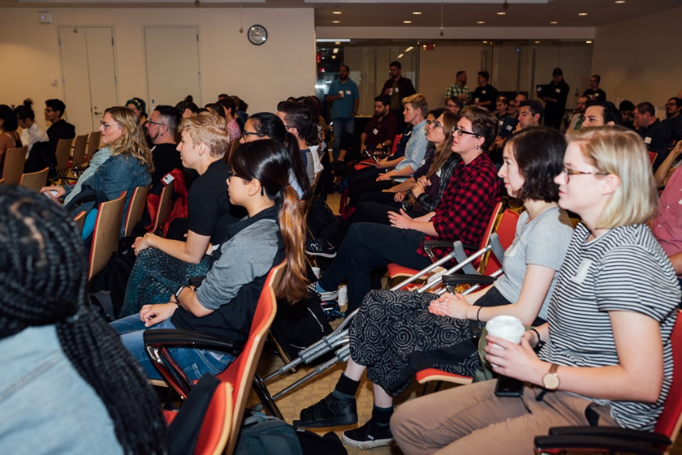
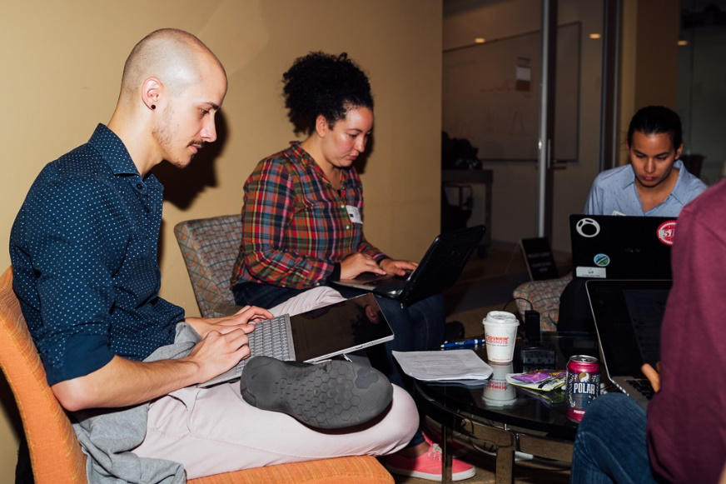
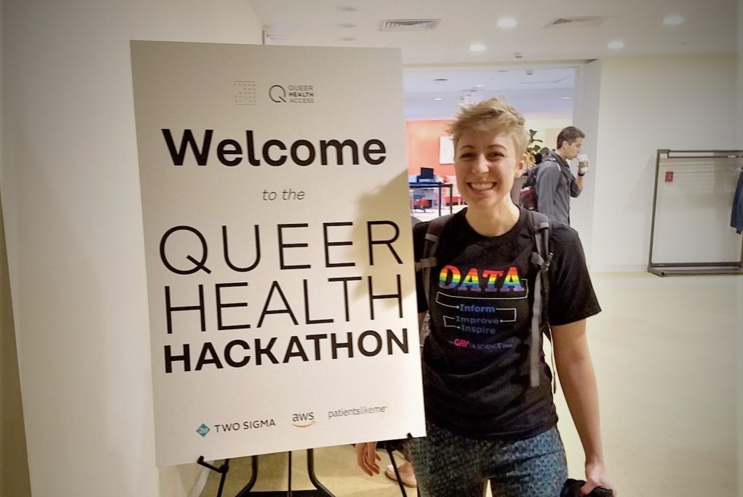
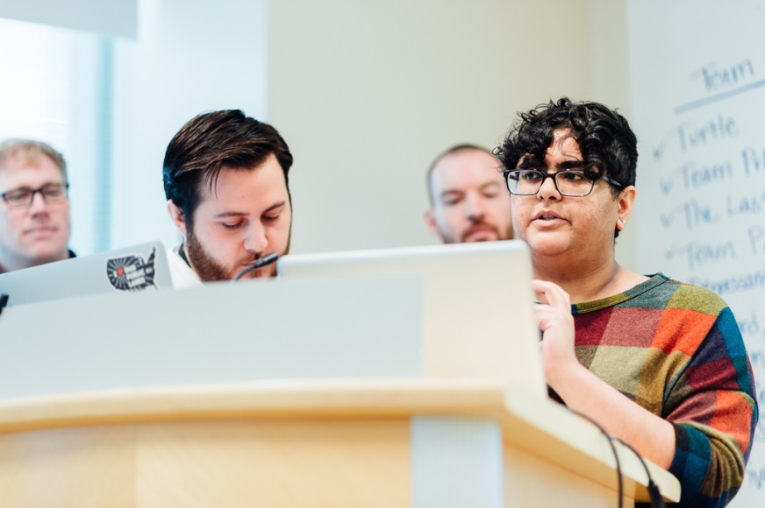
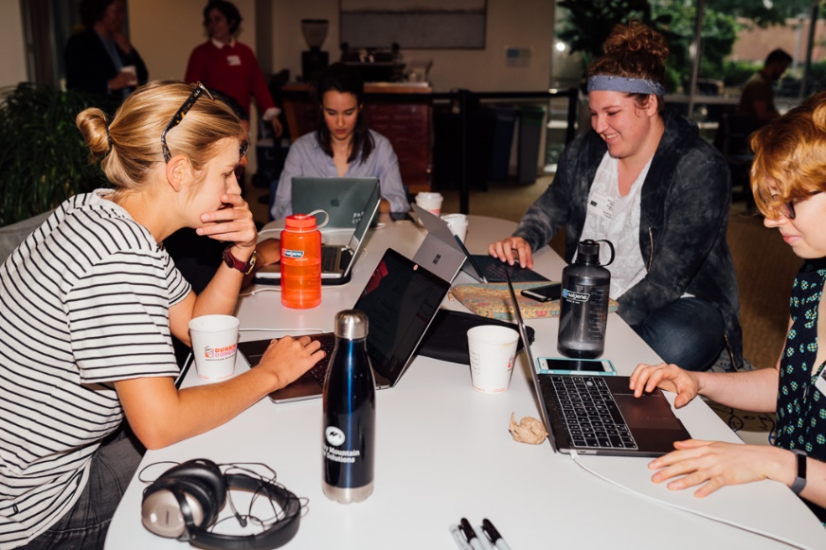
Queer Health Hackathon
Network Analysis 101
SNA IRL
DEMO
Queer Health Hackathon
Notes:
https://www.gaytascience.com/hacking-queer-healthcare/
Last year I was a part of the Queer Health Hackathon:
Brought together 75 data scientists, health providers, and policy experts to better understand health disparities in the LGBTQ+ community.
We were given access to a large de-identified patient-level dataset from a prominent academic medical center in the area. Sexual orientation and gender identity (SOGI) was well documented (HUGE deal by itself!) and LGBTQ+ patients made up 25% of the set.
The data lended itself to a variety of research questions including disease prevalence and clinical outcomes of the LGBTQ+ community (and different subgroups), SOGI data completeness and integrity, access to care, and intersectional identities.

Slide 41
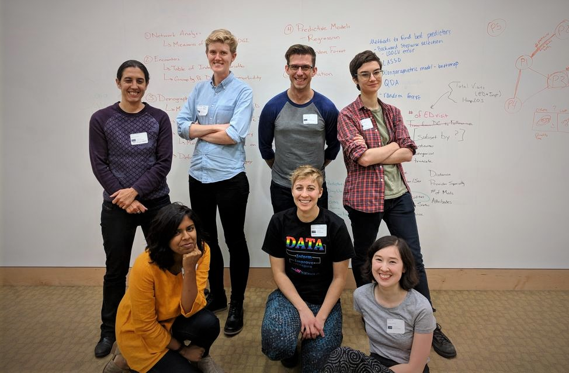
Queer Health Hackathon
How dense are the provider networks used by gender and sexual minorities?
How does this impact quality of care?
Network Analysis 101
SNA IRL
DEMO
Queer Health Hackathon
Notes:
I was part of a team looking to use SNA to explore issues related to healthcare access and quality of care. Explain our research goals, rationale.

Slide 42
Queer Health Hackathon – Methods
Providers
How dense are the provider networks used by gender and sexual minorities?
How does this impact quality of care?
Same Patient Visited Both Providers
Network Analysis 101
SNA IRL
DEMO
Queer Health Hackathon
Notes:
For the SNA portion of the project, we transformed the patient level data to build networks of providers.

Slide 43
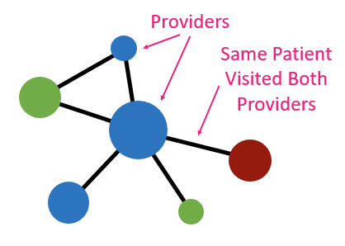
Queer Health Hackathon – Methods
1. Gender minority
2. Cisgender LGB
3. Cisgender heterosexual
How dense are the provider networks used by gender and sexual minorities?
How does this impact quality of care?
3
Density
Centrality
Network Analysis 101
SNA IRL
DEMO
Queer Health Hackathon
Notes:
We duplicated this network creation process 3 times, for each population of interest (gender minority, sexual minority, and cishet control). We then extracted some of the network statistics discussed previously to look for differences in the provider networks.

Slide 44
Queer Health Hackathon – Methods
1. Gender minority
2. Cisgender LGB
3. Cisgender heterosexual
How dense are the provider networks used by gender and sexual minorities?
How does this impact quality of care?
3
y
=
m
+b
Density
Centrality
Network Analysis 101
SNA IRL
DEMO
Queer Health Hackathon
Notes:
To see if network differences (potentially healthcare access) actually have an impact on quality of care for SGM patients, we used a simple linear model (briefly explain).

Slide 45
Queer Health Hackathon – Methods
1. Gender minority
2. Cisgender LGB
3. Cisgender heterosexual
How dense are the provider networks used by gender and sexual minorities?
How does this impact quality of care?
3
ER Visits
Stay Length
Follow Up
=
m
+b
Density
Centrality
Network Analysis 101
SNA IRL
DEMO
Queer Health Hackathon
Notes:
To see if network differences (potentially healthcare access) actually have an impact on quality of care for SGM patients, we used a simple linear model (briefly explain).

Slide 46
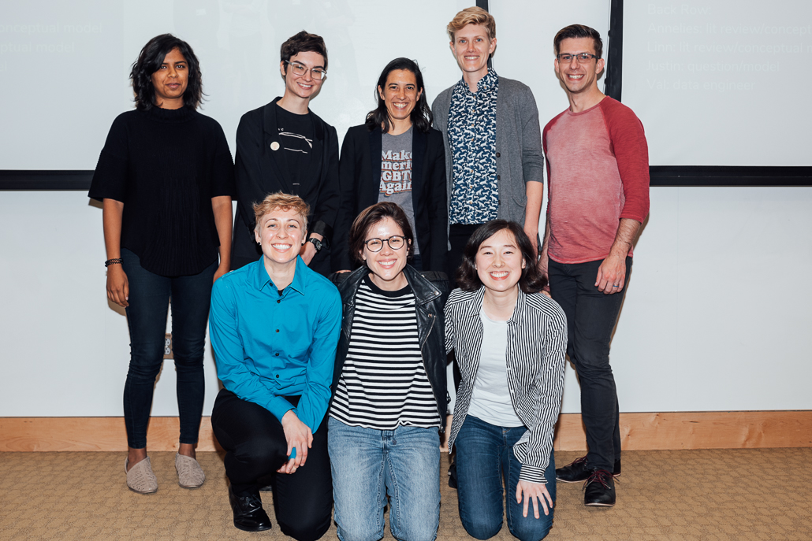


Queer Health Hackathon – Next Steps
Obtain provider attributes (specialty, demographics, etc.)
Consider additional networks (intersectional identities)
More efficient network calculations
Additional model variables (e.g. insurance status)
Network Analysis 101
SNA IRL
DEMO
Queer Health Hackathon
Notes:
Talk about the hackathon outcomes and the team’s next steps and future directions.

Slide 47
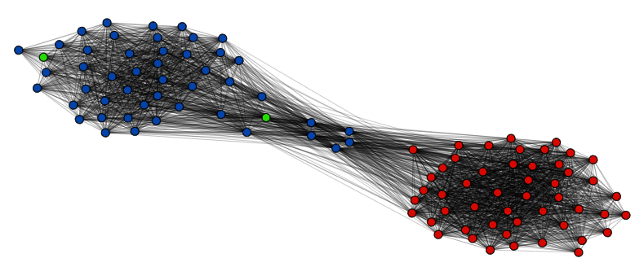
SNA Wrap Up
Powerful & versatile methods to gain insight into complicated social connection patterns
Applications across industry and academia – SO MANY OPTIONS!
Network Analysis 101
SNA IRL
DEMO
Queer Health Hackathon
Notes:
Recap the goals of the presentation.

Slide 48
Questions?
Kelsey Campbell
campkels@gaytascience.com
@campkels
www.GaytaScience.com
@gaytascience
Notes:
Q&A

